Slide 1

Notes:
Introduce myself. What are the expectation from this course?
How many familiar with machine learning,artificial intelligence?

Slide 2
Agenda
What is AI?
What is machine learning?
What are the different types of machine learning?
What is generalization ,over-fitting and under-fitting?
What is?

Slide 3

Why did HAL 9000 refuse to follow the order ?
“I am sorry Dave, I’m afraid I can’t do that”
- HAL 9000,
2001 - A Space Odyssey
(Directed by Stanley Kubrick)

Slide 4
For any machine to be called AI, it should either think or interact like humans do?
Can it interact with external world like humans?
General Purpose AI
General purpose context
Adaptive
Narrow / Limited context
Narrow AI
Think
Can it think like humans do?
Automation
Pre defined
Transactional
Context aware & natural
Interact
Notes:
Give reference of turing’s test : Fool a human being into interacting with another human,that machine can be called intelligent

Slide 5
AI systems should either think or interact like humans do?
Enabling Technologies
Machine learning (Reason)
Big Data technologies (Synthesize )
General Purpose AI
General purpose context
Adaptive
Narrow / Limited context
Sift Science (ML Fraud detection)
IBM Watson
HAL 9000
Narrow AI
Google Self Driving cars
Think
(Synthesize & Reason)
Can it think like humans do?
Robotic process automation
IPSoft Amelia
Automation
Enabling Technologies
Computer Vision (Observe)
NLP, Speech recognition (Communicate)
Pre defined
Runbook / Scripting
Transactional
Context aware & natural
Interact
(Observe & Communicate)
Can it interact with external world like humans?
Notes:
Jeopardy – Quiz show IBM watson defeated champions

Slide 6
What is machine learning?
Machine learning is a type of artificial intelligence (AI) that provides computers with the ability to learn without being explicitly programmed. Machine learning focuses on the development of computer programs that can change when exposed to new data. The process of machine learning is similar to that of data mining.
“A computer program is said to learn from experience E with respect to some class of tasks T and performance measure P,if its performance at tasks in T, as measured by P, improves with experience ”
- T.Mitchell(1997)
Notes:
In London

Slide 7
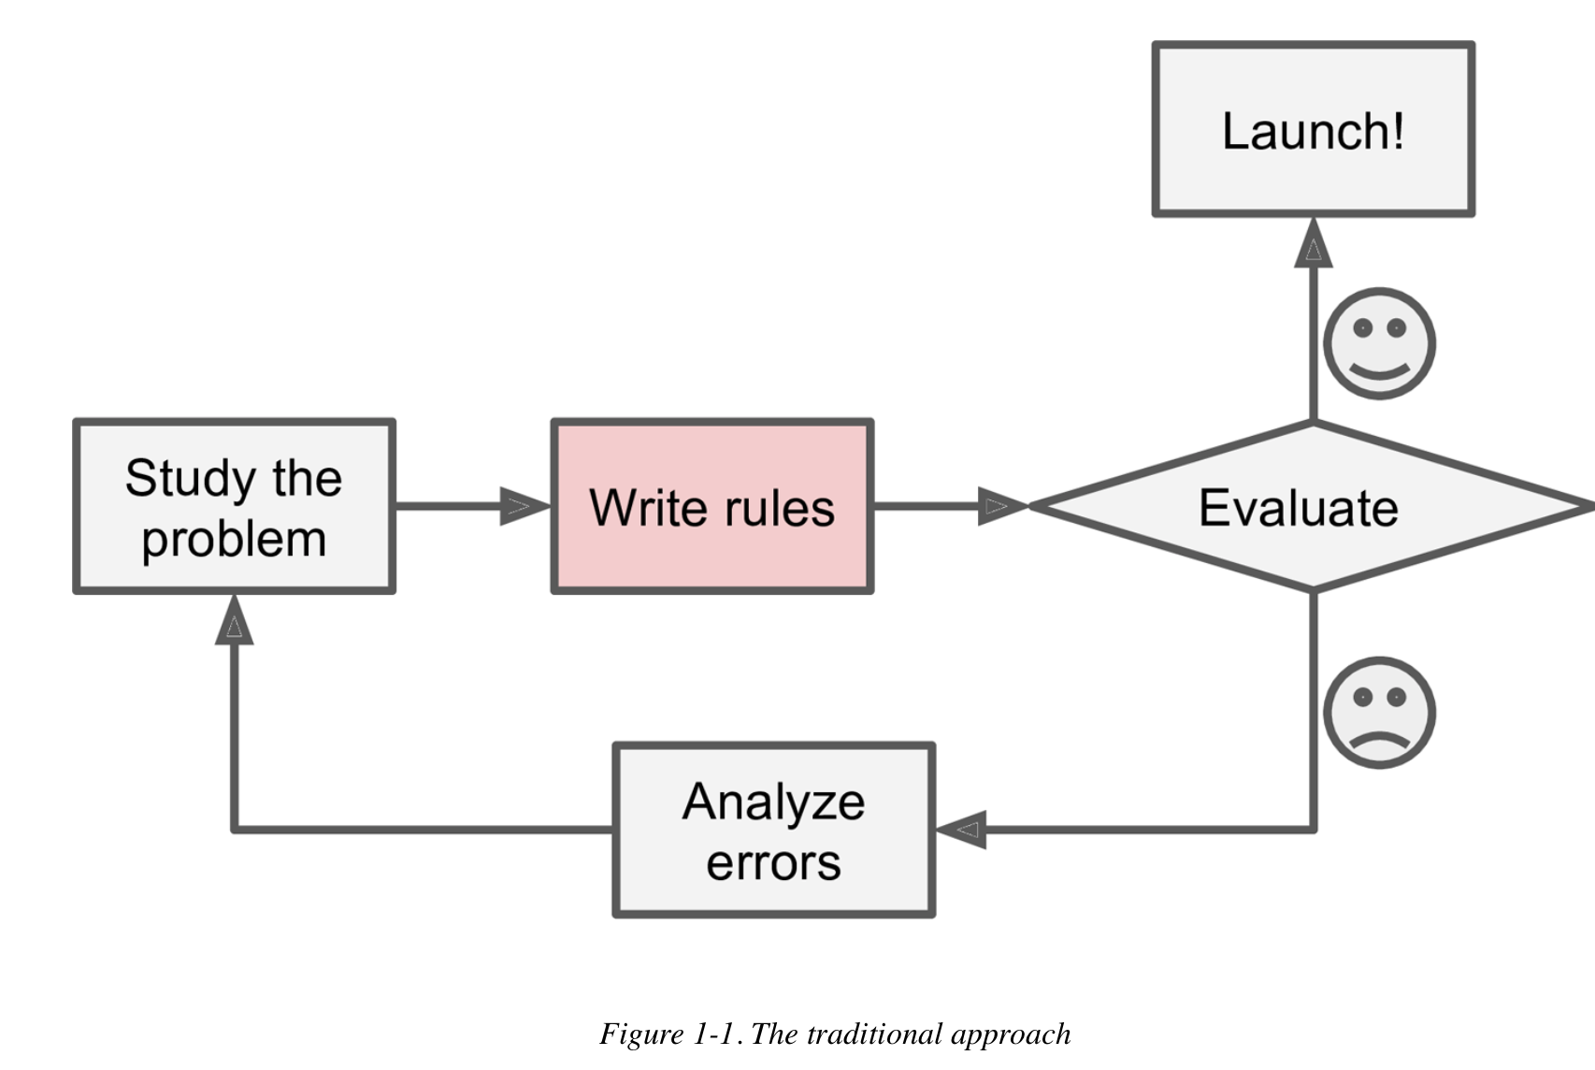
Traditionally
Notes:
Example – Spam classification

Slide 8
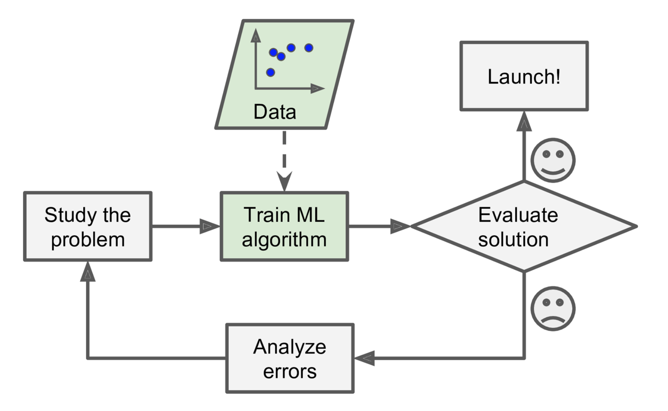
Machine learning based approach - 1
Notes:
In London

Slide 9
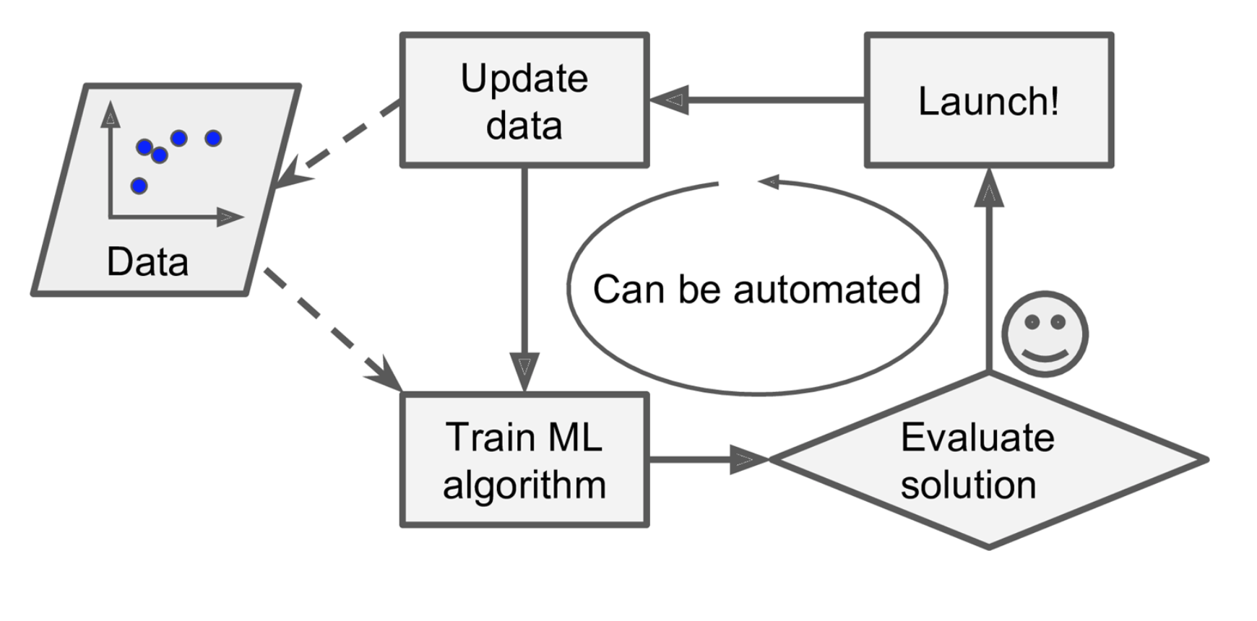
Machine learning based approach - 2
Notes:
In London

Slide 10
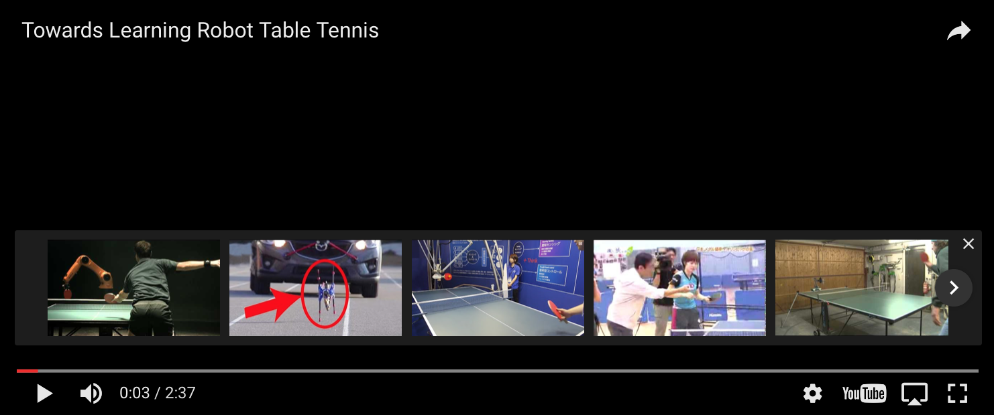
Towards learning robot table tennis

Slide 11
Types of machine learning
Supervised Learning
Unsupervised Learning
Reinforcement Learning
Makes machine learn explicitly
Data with clearly defined output is given
Direct feedback is given
Predicts outcome/future
Classification/Regression
Machine understands the data(Identifies patterns/structures)
Evaluation is qualitative or indirect
Does not predict or find anything specific
Reward based learning
Learning from +ve and –ve reinforcement
Machine learns how to act in a certain environment
To maximize rewards

Slide 12
Supervised Learning
Housing price prediction
400
300
Price ($) in 1000’s
200
100
0 500 1000 1500 2000 2500 3000
Size in square feet
Notes:
In London

Slide 13
Regression
Housing price prediction
400
300
Price ($) in 1000’s
200
Rights answers given
Regression - Predict continuous values output(price)
100
7500
0 500 1000 1500 2000 2500 3000
Size in square feet
Notes:
In London
N

Slide 14
Classification Problem
x2
x2
x1
x1
Notes:
In London

Slide 15
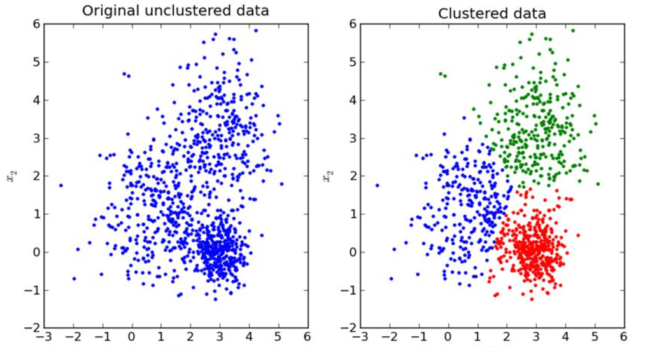
Unsupervised Learning
Given the data give me some description of data – Structure the data
Notes:
No one is telling u to how to divide,you know you have to divide,supervised learning tells exactly how to divide the world unsupervised no one does.
Clustering: Take a collection of 1,000,000 different genes, and find a way to automatically group these genes into groups that are somehow similar or related by different variables, such as lifespan, location, roles, and so on.
Non-clustering: The "Cocktail Party Algorithm", allows you to find structure in a chaotic environment. (i.e. identifying individual voices and music from a mesh of sounds at a cocktail party).
Reinforcement learning : Tic tac toe program getting better everytime it plays a tic tac ,reward could be a win.

Slide 16
Exercise
Suppose you have to predict whether sun will rise today, based on the trend that you know of for the past 2 months based on certain parameters. What kind of problem it is?
Classification/Regression?
Suppose you have patient history based on age, race and other parameters it is known whether the a tumor was cancerous or benign. Given a patient with a tumor predict whether he/she has cancer or not
Suppose you are working on stock market prediction, and you would like to predict the price of a particular stock tomorrow (measured in dollars). You want to use a learning algorithm for this. Would you treat this as a classification or a regression problem?
Notes:
In London

Slide 17
Generalization
The whole point of machine learning is generalization.
Generalization usually refers to a ML model's ability to perform well on new unseen data rather than just the data that it was trained on. It is strongly related to the concept of overfitting. If your model is over fitted then it will not generalize well.
Notes:
The ability of the learned model to fit unseen instance.

Slide 18
Generalization
Notes:
In London

Slide 19
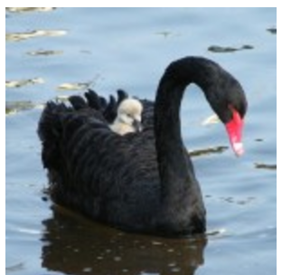
Inductive Bias
The theoretical assumption that must be added to transform the algorithm's outputs into logical deductions.
Notes:
Assumption made when choosing the model – For example in linear regression the model assumes that the output or dependent variable is related to independent variable linearly. This is inductive bias in the mode
Maybe you’ve assumed a new swan sighting will be the same color as the most common color of the 5 nearest previous sightings. That would be a k-nearest neighbor classifier. Maybe you’ve assumed each swan color has a normal distribution about a certain latitude. That would be a Naive Bayes classifier. Maybe you’ve assumed the swan color distribution can be represented using 20 properly scaled and rotated sigmoidal functions over location. That could be handled by building an artificial neural network. Which one of these is the “right” answer? Well, It depends.

Slide 20
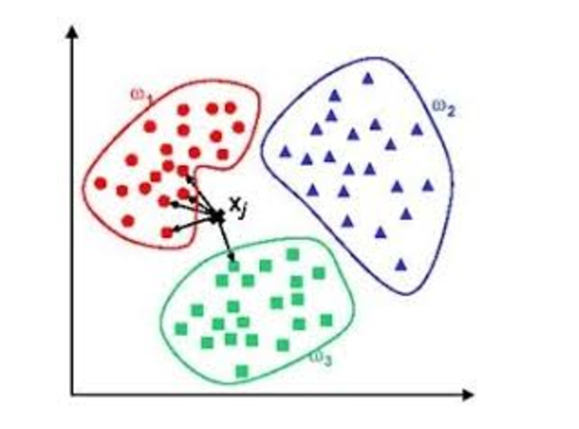
Instance vs model based learning
In machine learning, instance-based learning (sometimes called memory-based learning^{[1]}) is a family of learning algorithms that, instead of performing explicit generalization, compares new problem instances with instances seen in training, which have been stored in memory. – Source Wikipedia

Slide 21
Main challenges of machine learning
Insufficient quantity of training data
Non-representative training data
Poor quality data
Overfitting
Under fitting
Irrelevant features

Slide 22
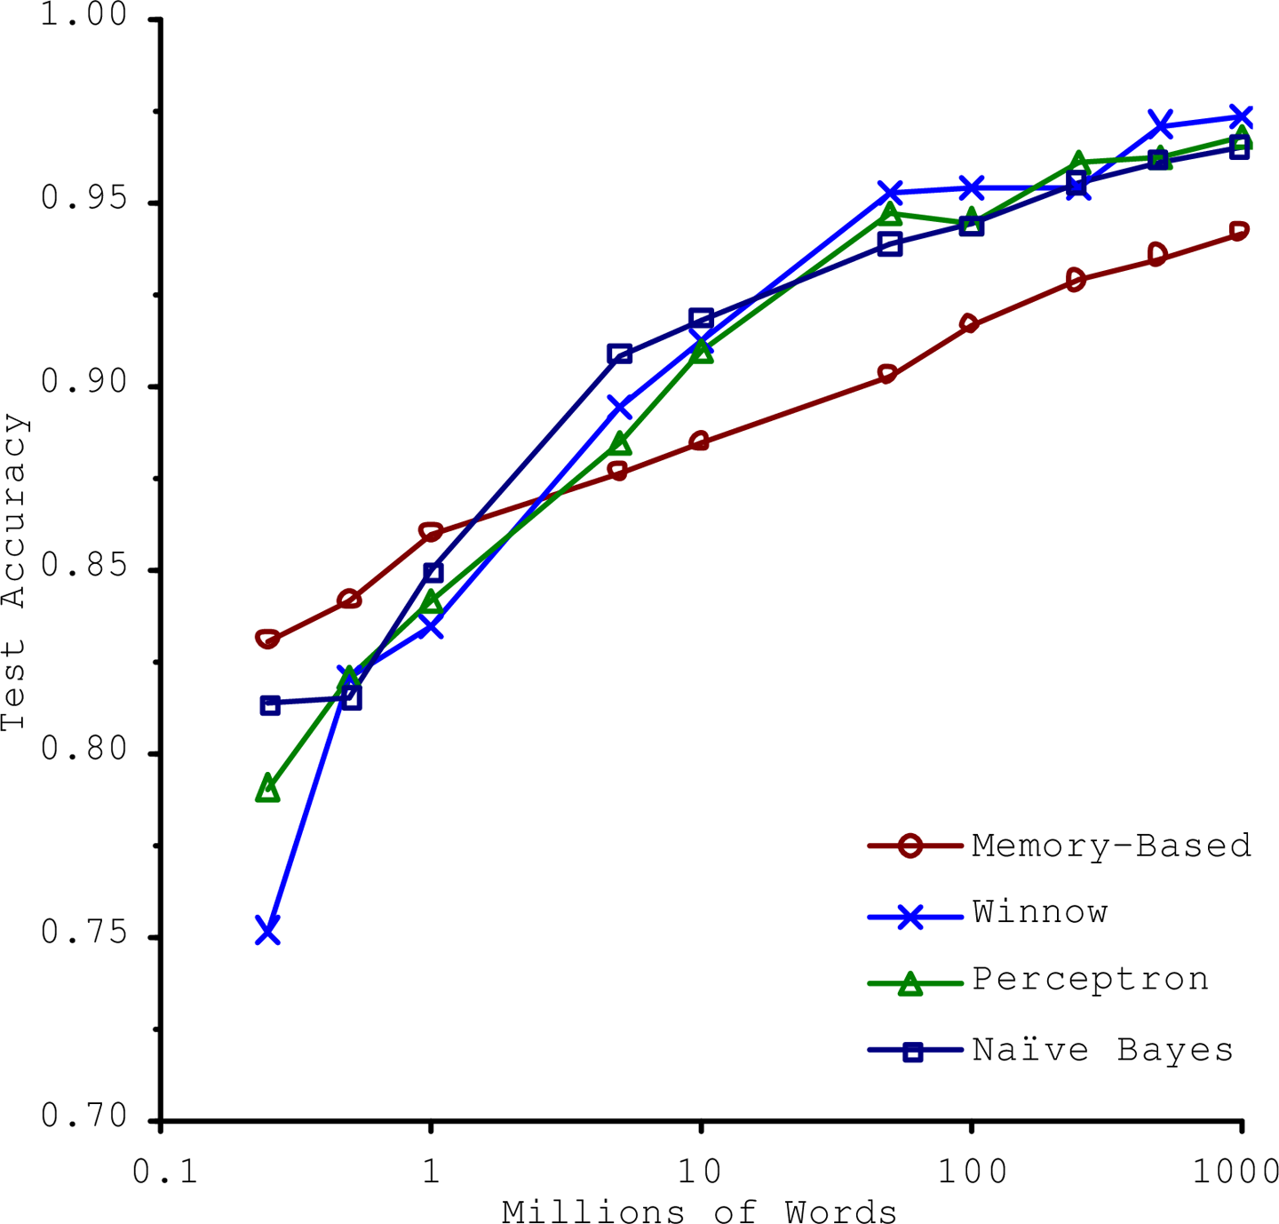
Effectiveness of data
Notes:
Natural language disambiguation

Slide 23
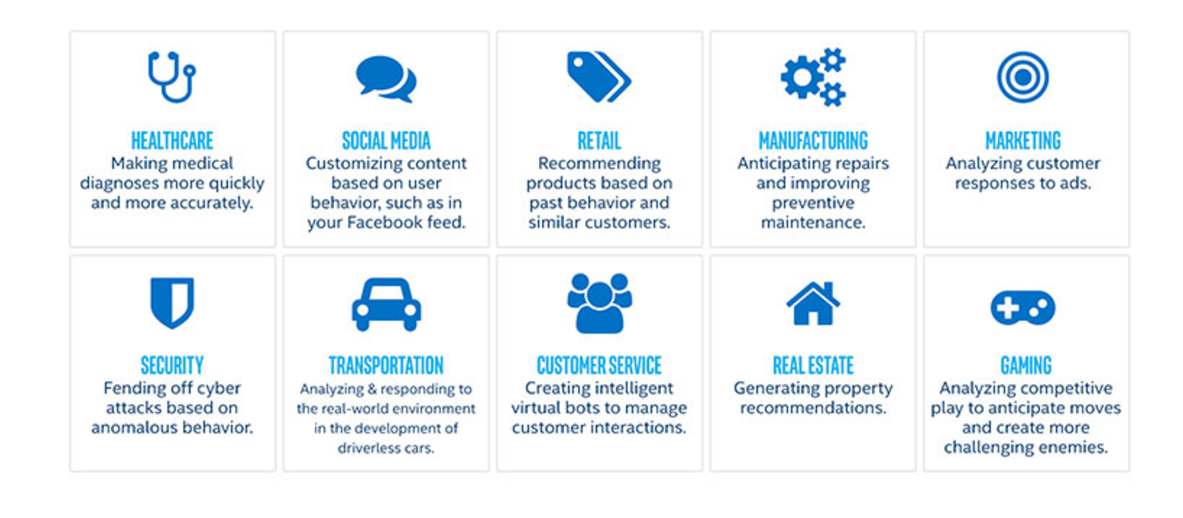
Applications of Machine learning
Notes:
In London

Slide 24
Naming few are:
Speech recognition
Voice/Face/Finger print recognition
Natural Language Processing - Sentiment analysis/Language identification and translation
Medical diagnosis
Recommendations engines and Market basket analysis
Spam detection
Bioinformatics/computational biology
Content (image, video, text) categorization
Notes:
In London

Slide 25
How to design for a machine learning problem ?
Data
Feature Selection
Model Selection
Learning
Evaluation
Notes:
In London

Slide 26
How to design for a machine learning problem ?
Data
Feature Selection
Model Selection
Learning
Evaluation
Notes:
In London

Slide 27
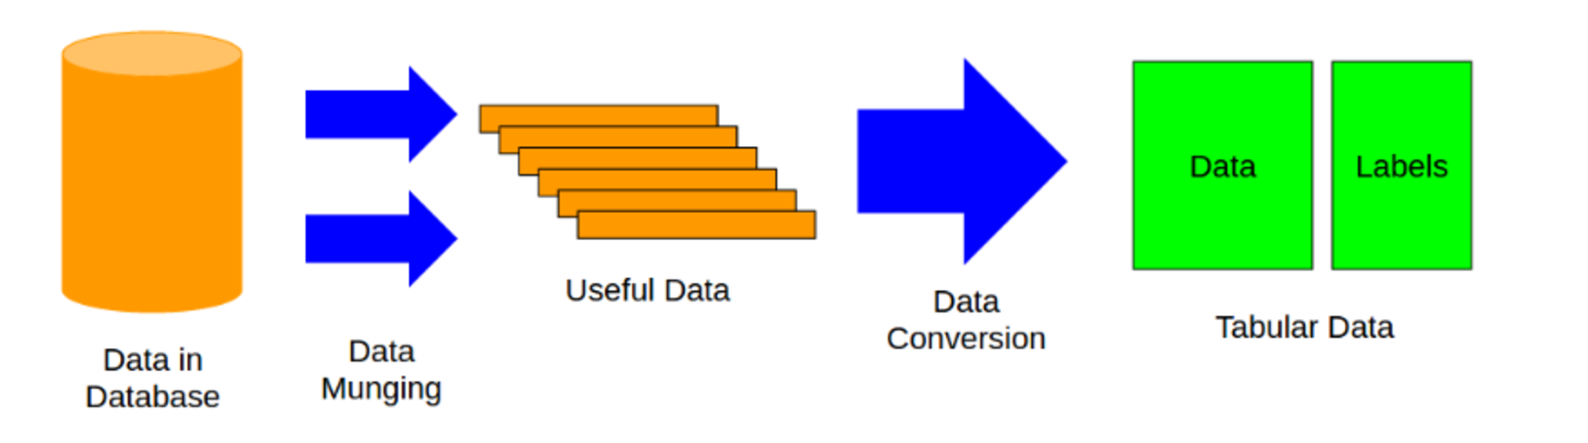
Data
Notes:
In London

Slide 28
How to design for a machine learning problem ?
Data
Feature Selection
Model Selection
Learning
Evaluation
Notes:
In London

Slide 29
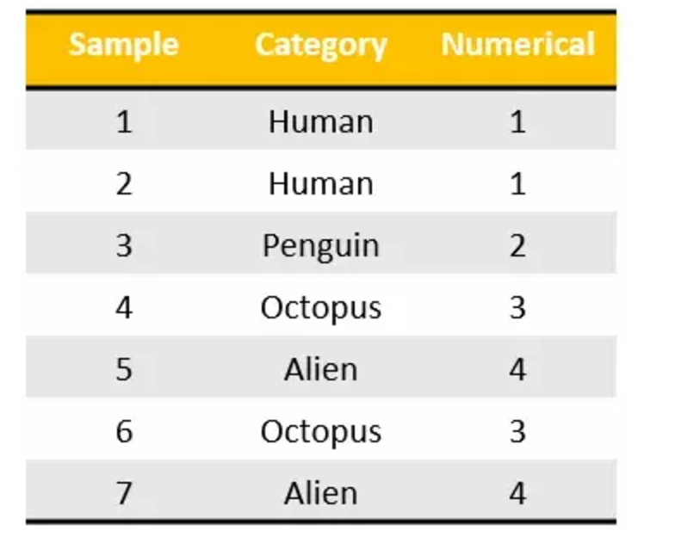
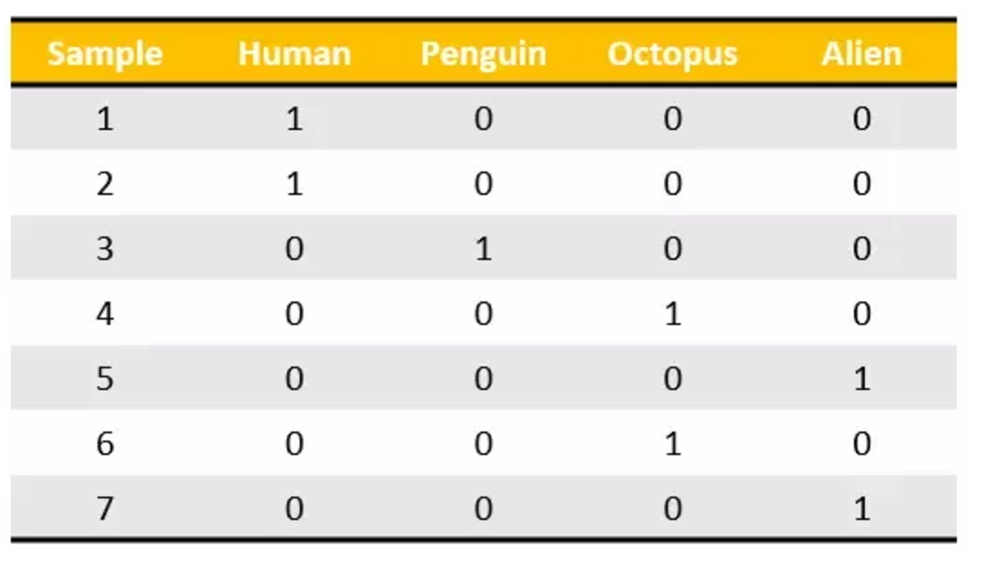
Feature scaling ,label encoding and one hot encoding
Notes:
Mathematically, one hot encoding produces a balanced matrix, which is easy to understand during complex computations inside algorithms.

Slide 30
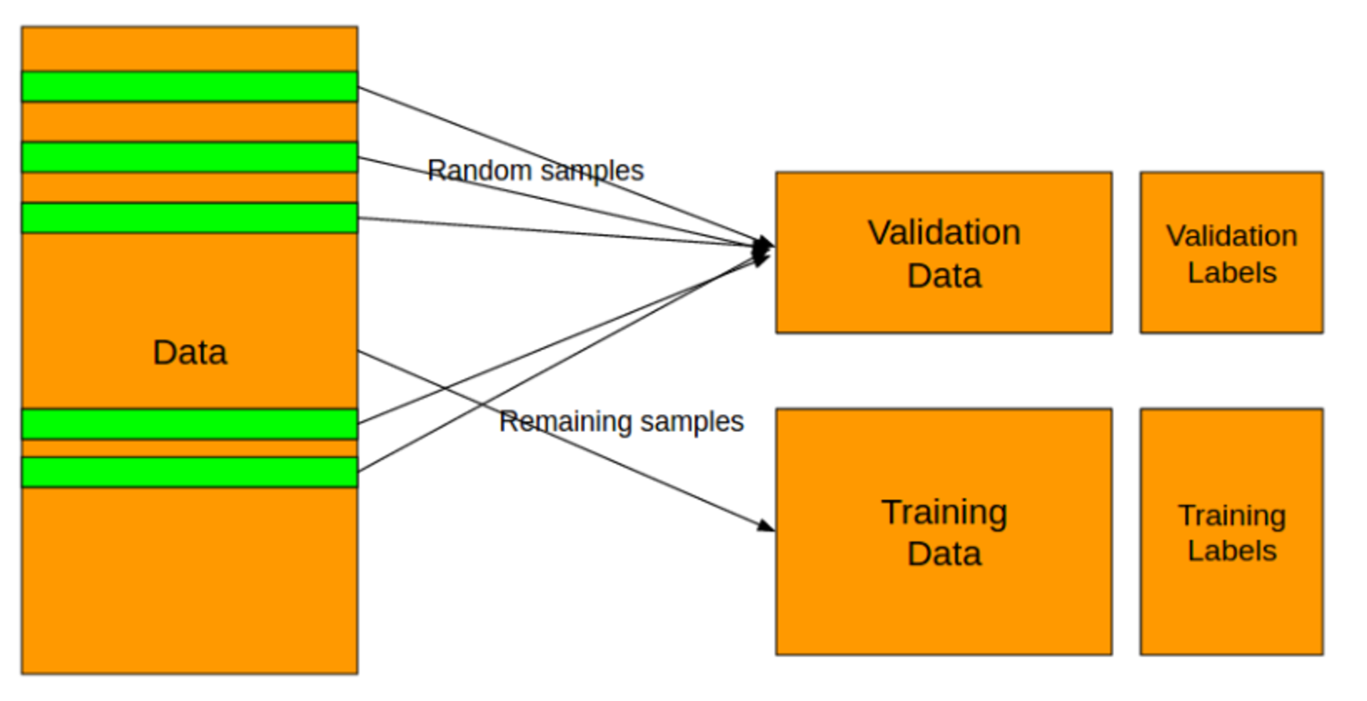
Split the data set
Notes:
In London

Slide 31
How to design for a machine learning problem ?
Data
Feature Selection
Model Selection
Learning
Evaluation
Notes:
In London

Slide 32
Identify the problem
Multi-variable regression
Multi classification problem
Classification problem
Binary classification problem
Notes:
In London

Slide 33
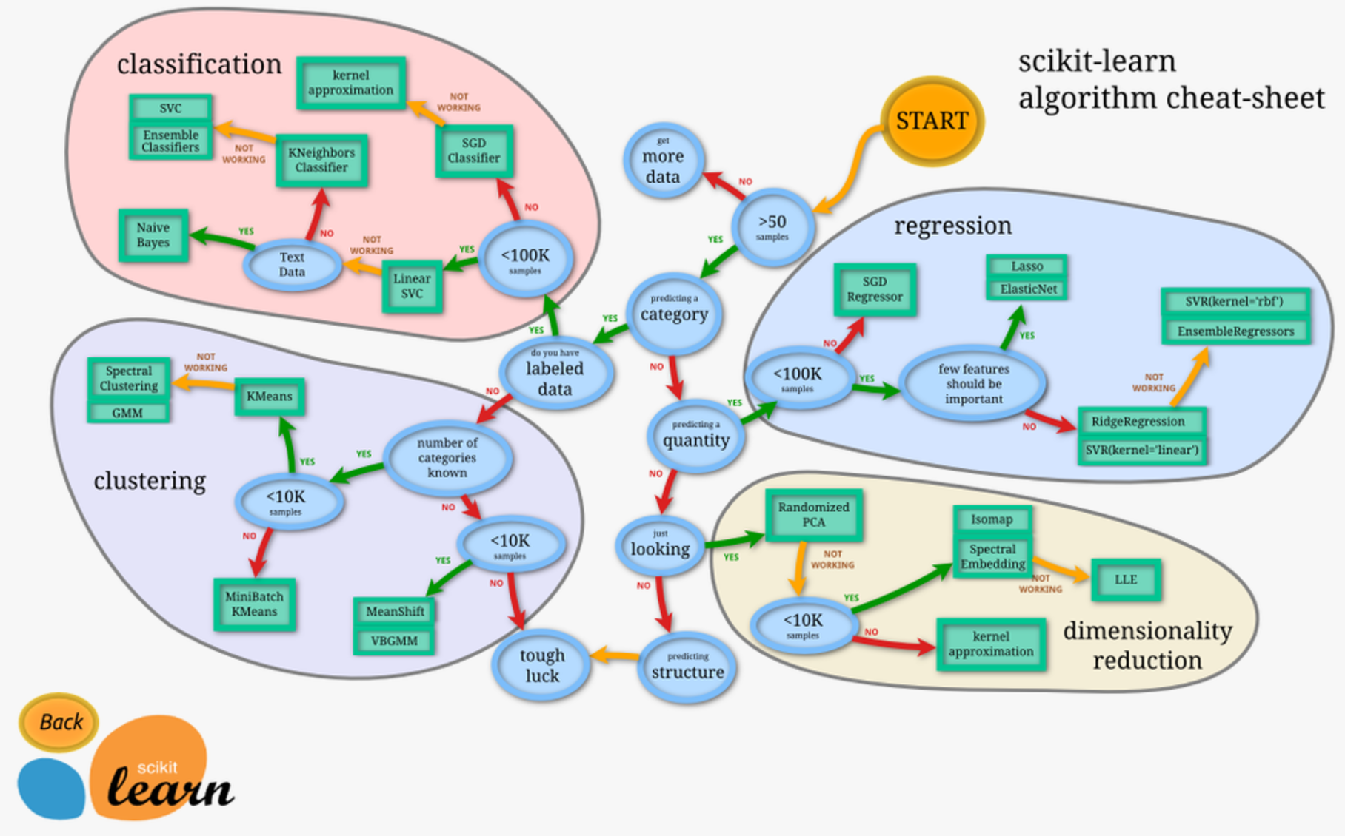
Notes:
In London

Slide 34
How to design for a machine learning problem ?
Data
Feature Selection
Model Selection
Learning
Evaluation
Notes:
In London

Slide 35
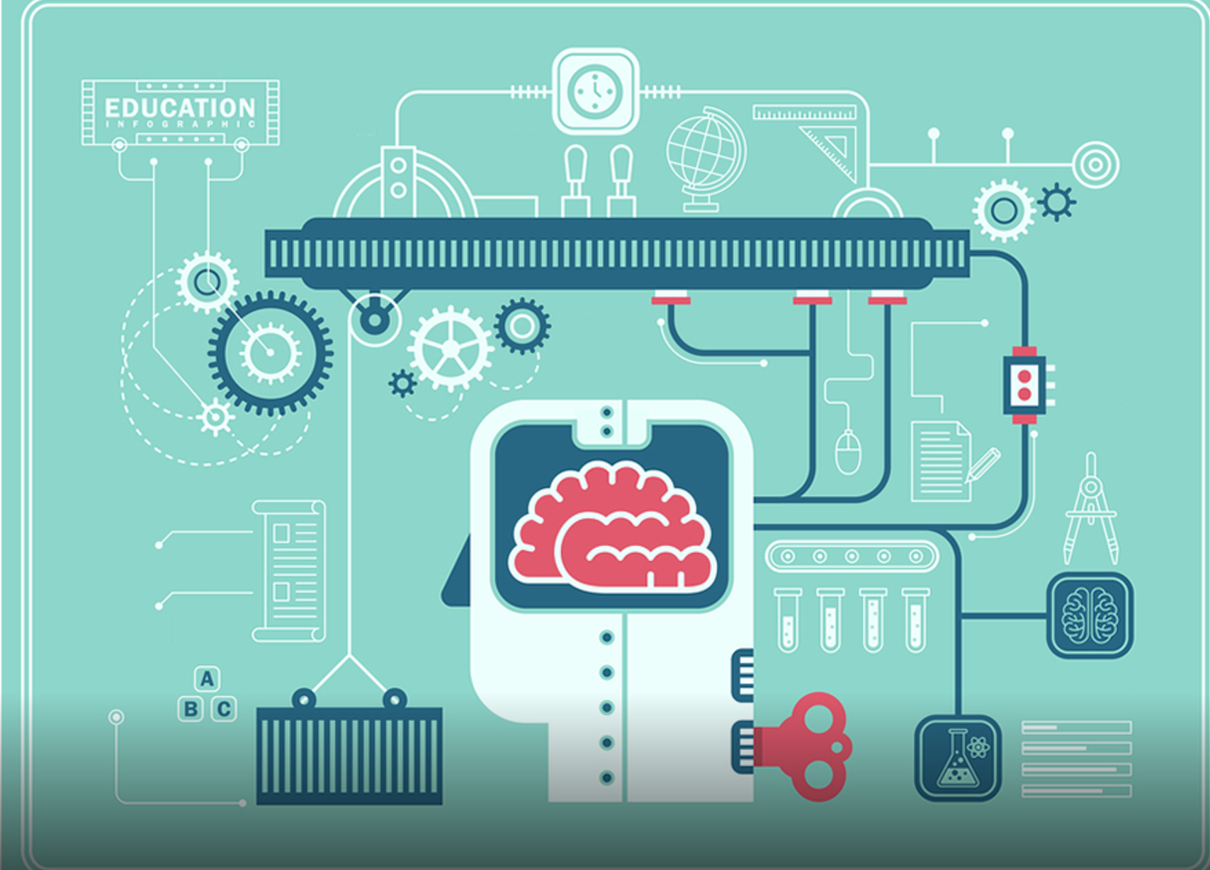
Actual learning
Notes:
In London

Slide 36
How to design for a machine learning problem ?
Data
Feature Selection
Model Selection
Learning
Evaluation
Notes:
In London

